Slide 1

People Welfare Organization
Presented By:
Ashwin Venkata Krishnan
Ashutosh Raichurkar
Arunbalaji srinIvasan

Slide 2
PROBLEM STATEMENT
According to the US Department of Housing and Urban Development's Annual Homeless Assessment Report, as of 2018, there were around 553,000 homeless people in the United States on a given night.
Homeless people are at relatively high risk for a broad range of acute and chronic illnesses.
The reason for deteriorating health conditions of the homeless people in this country and many other countries is the lack of organized health care system.

Slide 3
Our Approach to Solve this Issue
To make health care easily accessible for homeless people by integrating hospital, NGO and fundraising enterprises.
Our approach focuses on creating a well organized help and financial system to fund the health expenses of the homeless people.
Finally, the hospital helps in curing the disease identified, based on the criticality diagnosed by various health organizations.

Slide 4

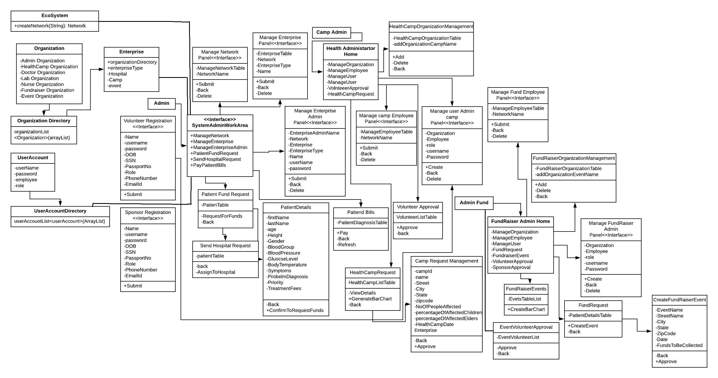



Class Diagram

Slide 5
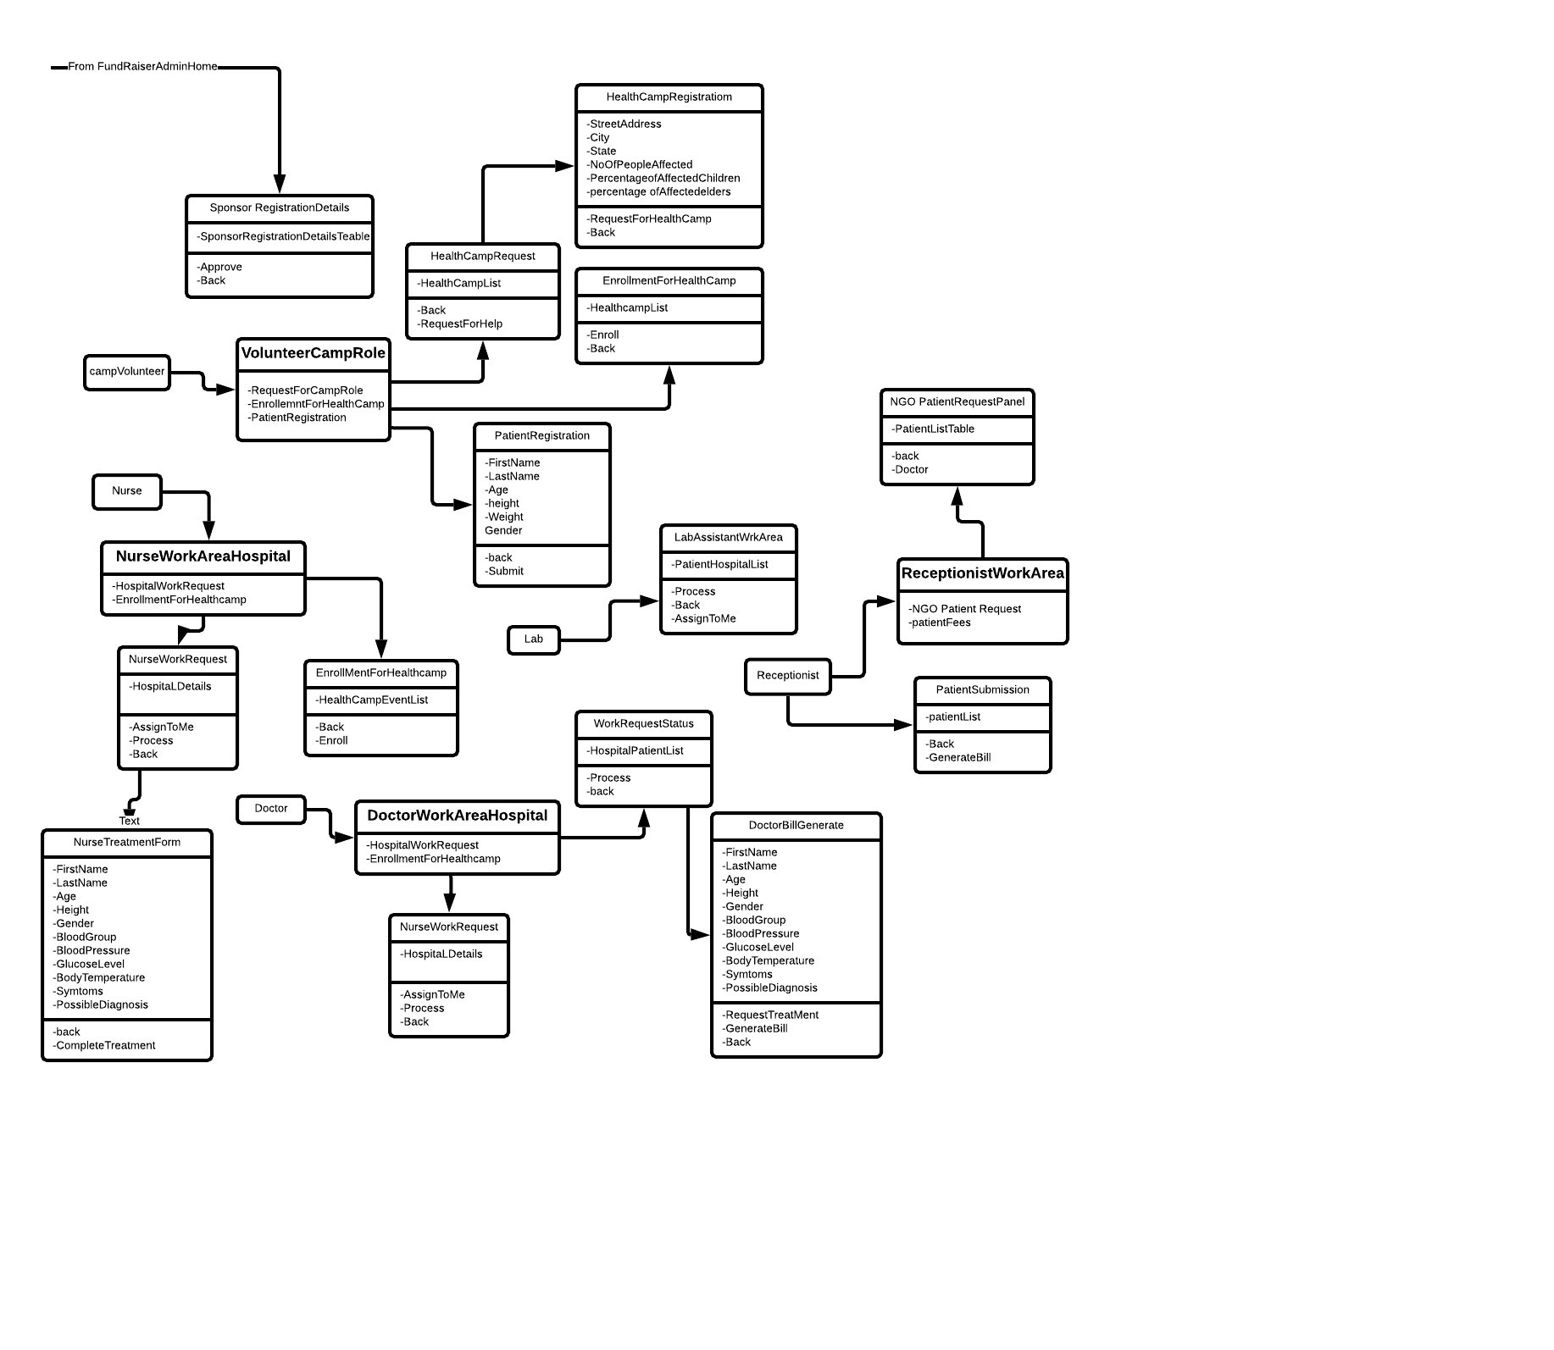
Class Diagram

Slide 6
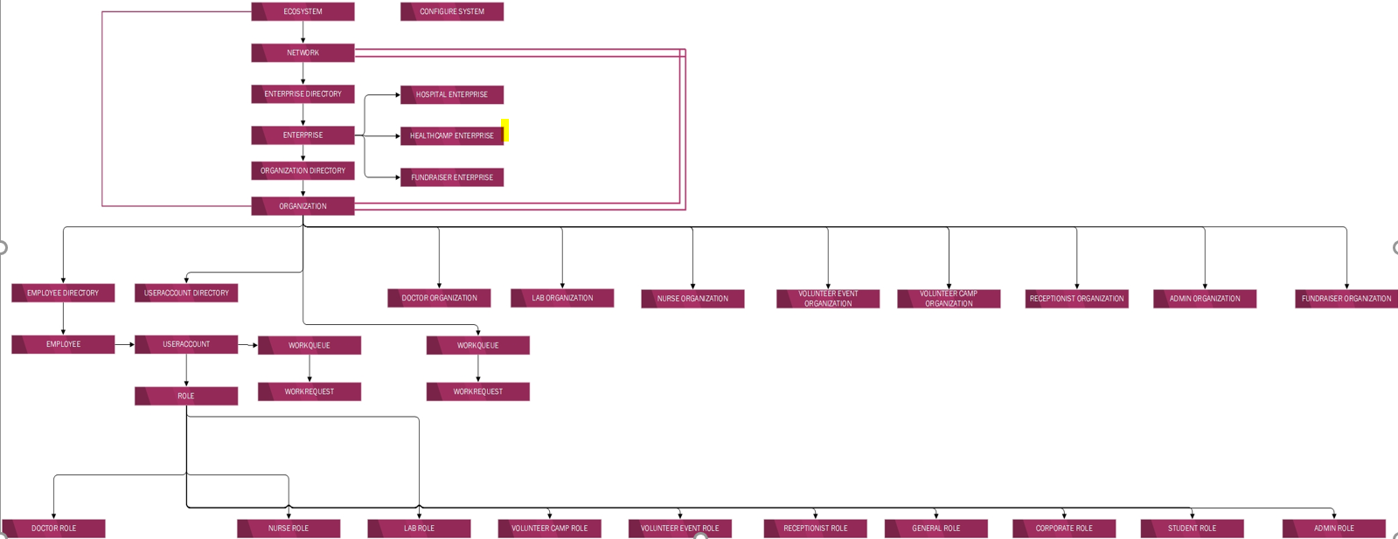

People Welfare Organization - Object Model

Slide 7
Our Use Cases
Provide Medical Assistance for the homeless people
Provide expert diagnosis and treatment from Doctor on the patient’s health condition.
Provide test report from labs to determine the root cause of the illness.
Provide nurse assistance for quick distribution of medication.

Slide 8
Our Use Cases
Collecting large amount of funds to treat homeless patients on a large scale
Having the Event Volunteers create various Fundraising Events to collect money for treating the deteriorating conditions of the homeless.
Having the Sponsors enroll for Fundraising events through an User Friendly Application.
Having the admin of the health camp sanction funds to take care of the medical needs of the homeless patients.

Slide 9
Our Use Cases
Having the Homeless people with severe health conditions be smoothly registered with the Hospitals.
Have the Volunteers register a sick homeless person to a Hospital.
Have the volunteer provide assistance in filling the details of the patient while registering.

Slide 10
Key Screenshots

Slide 11
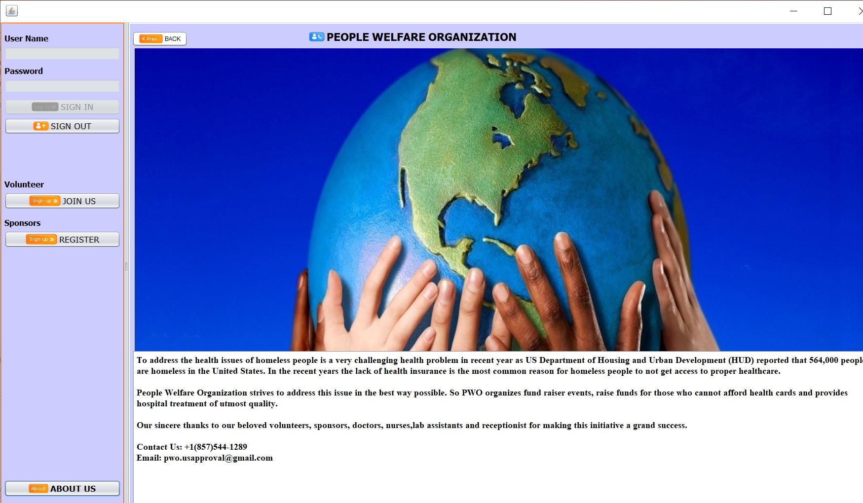
About Us!
Admin Login

Slide 12

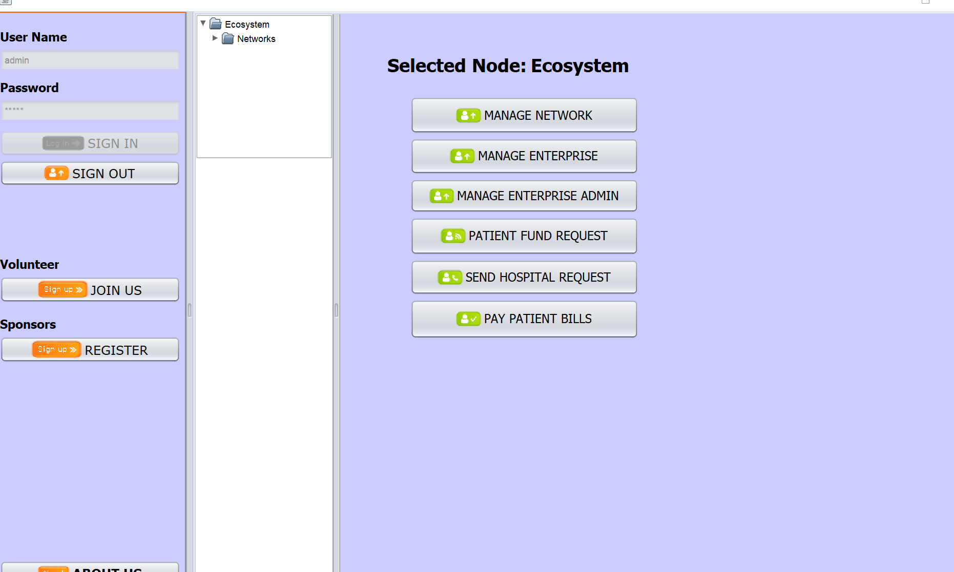
Admin Login

Slide 13
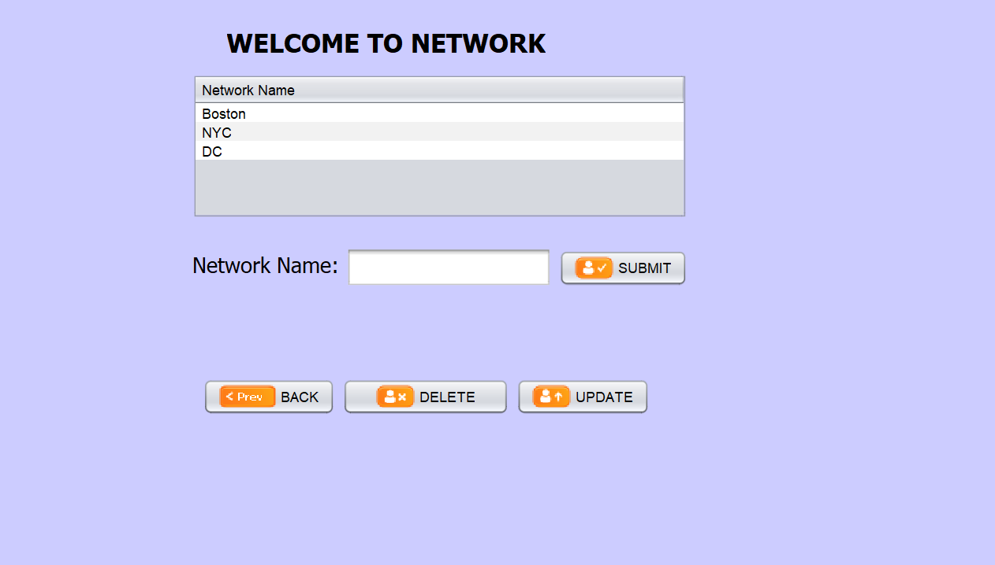
Patient Registration
Creating a Network

Slide 14
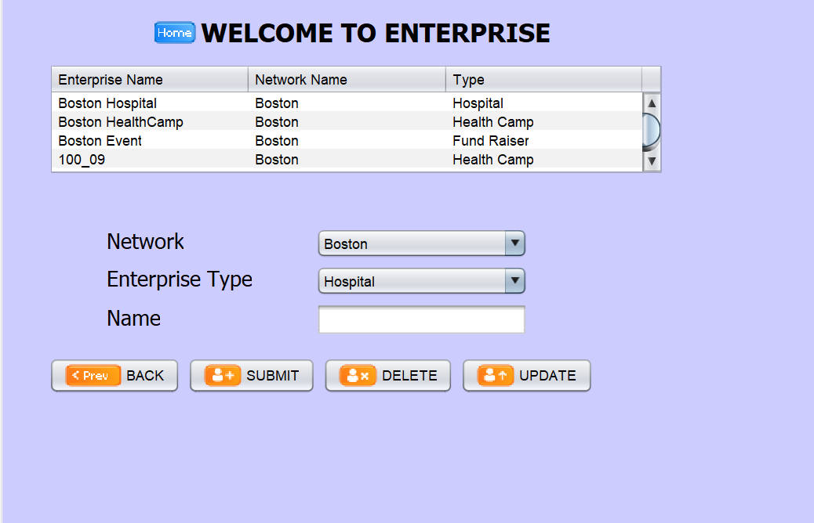
Patient Registration
Creating an Enterprise

Slide 15
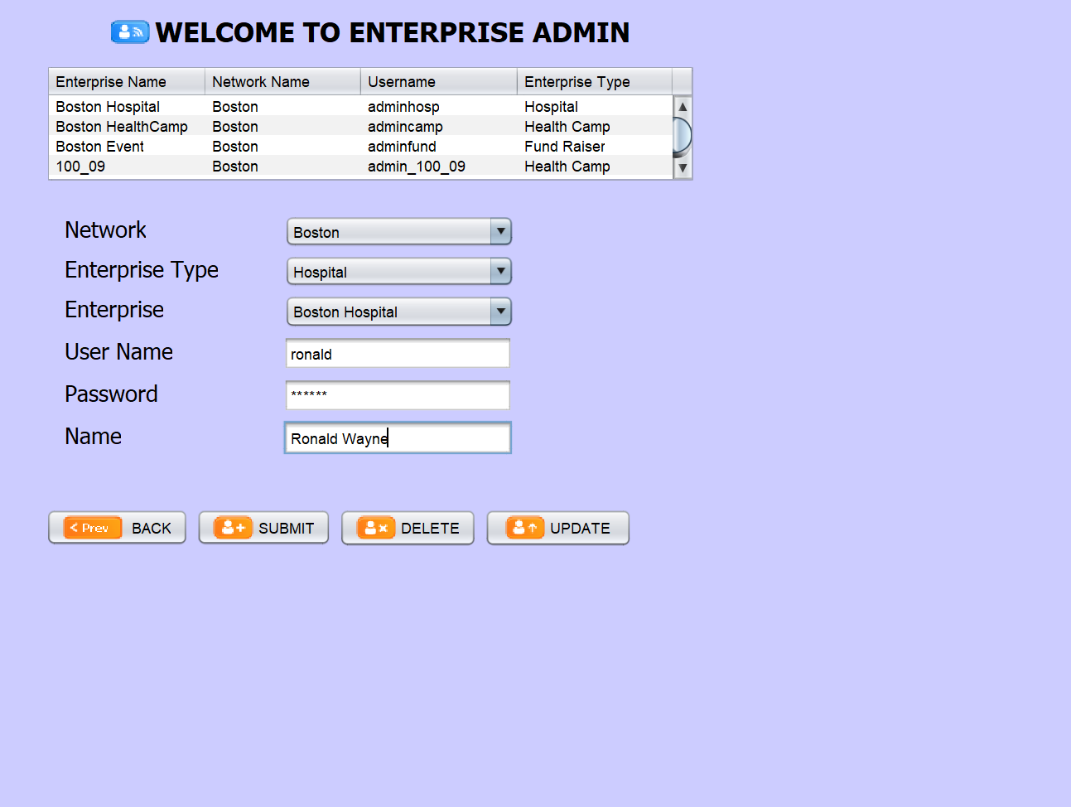
Creating Admin Logins for Enterprise

Slide 16
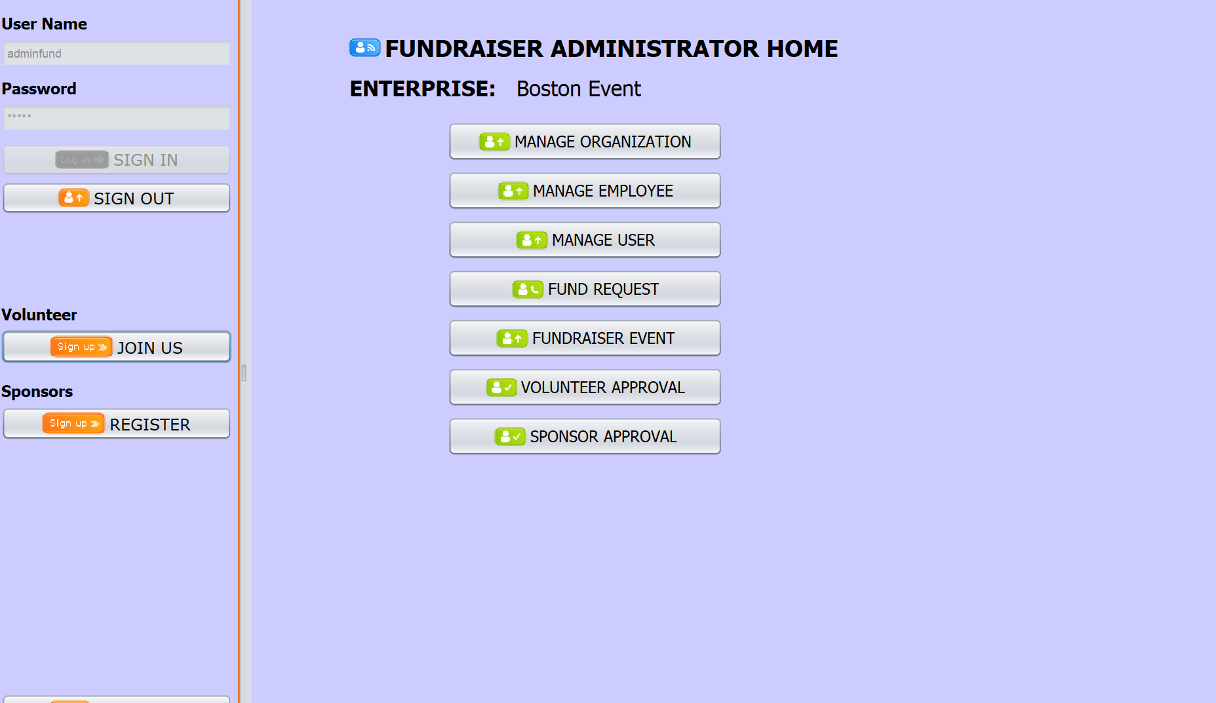
Fundraiser Admin Login

Slide 17
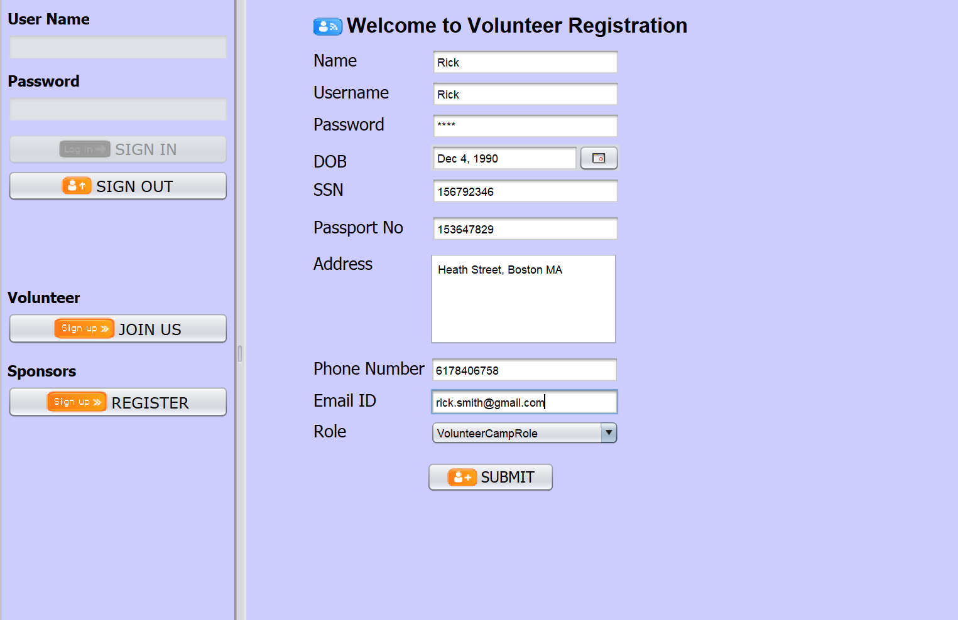
Health Camp Admin Login
Volunteer Registration

Slide 18
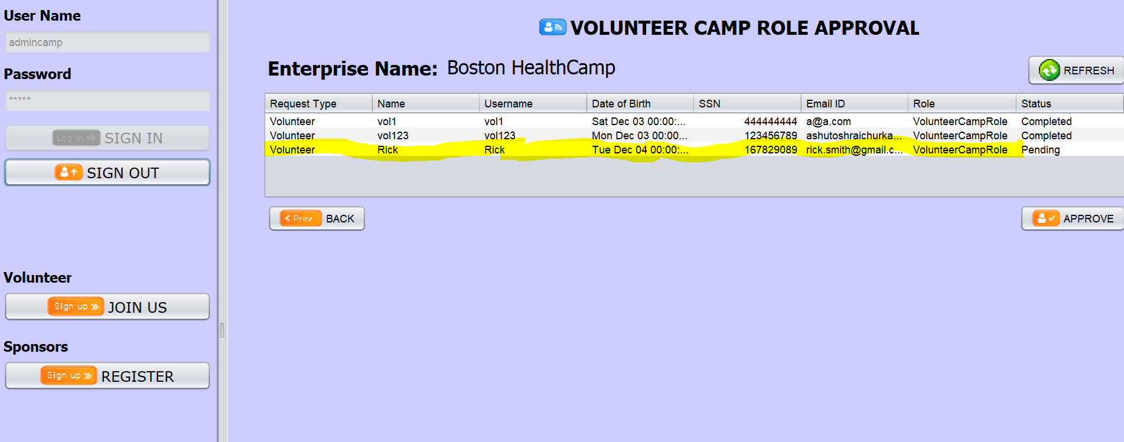
Health Camp Admin Login
Volunteer Approval

Slide 19
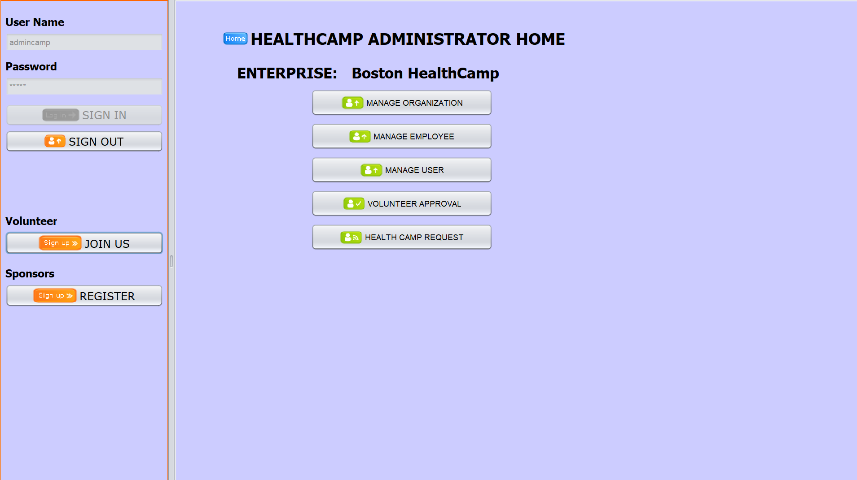
Health Camp Admin Login

Slide 20
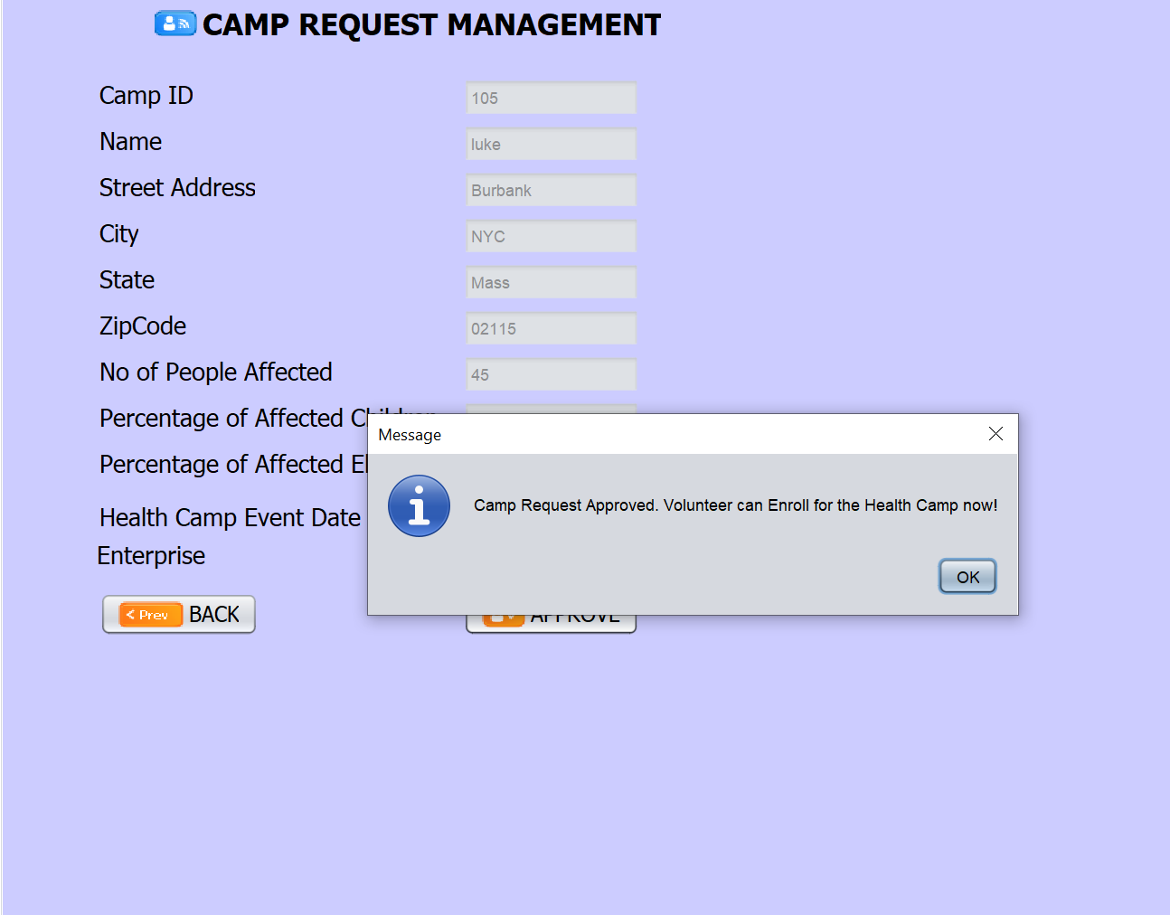
Nurse Work Area
Health Camp Approval

Slide 21
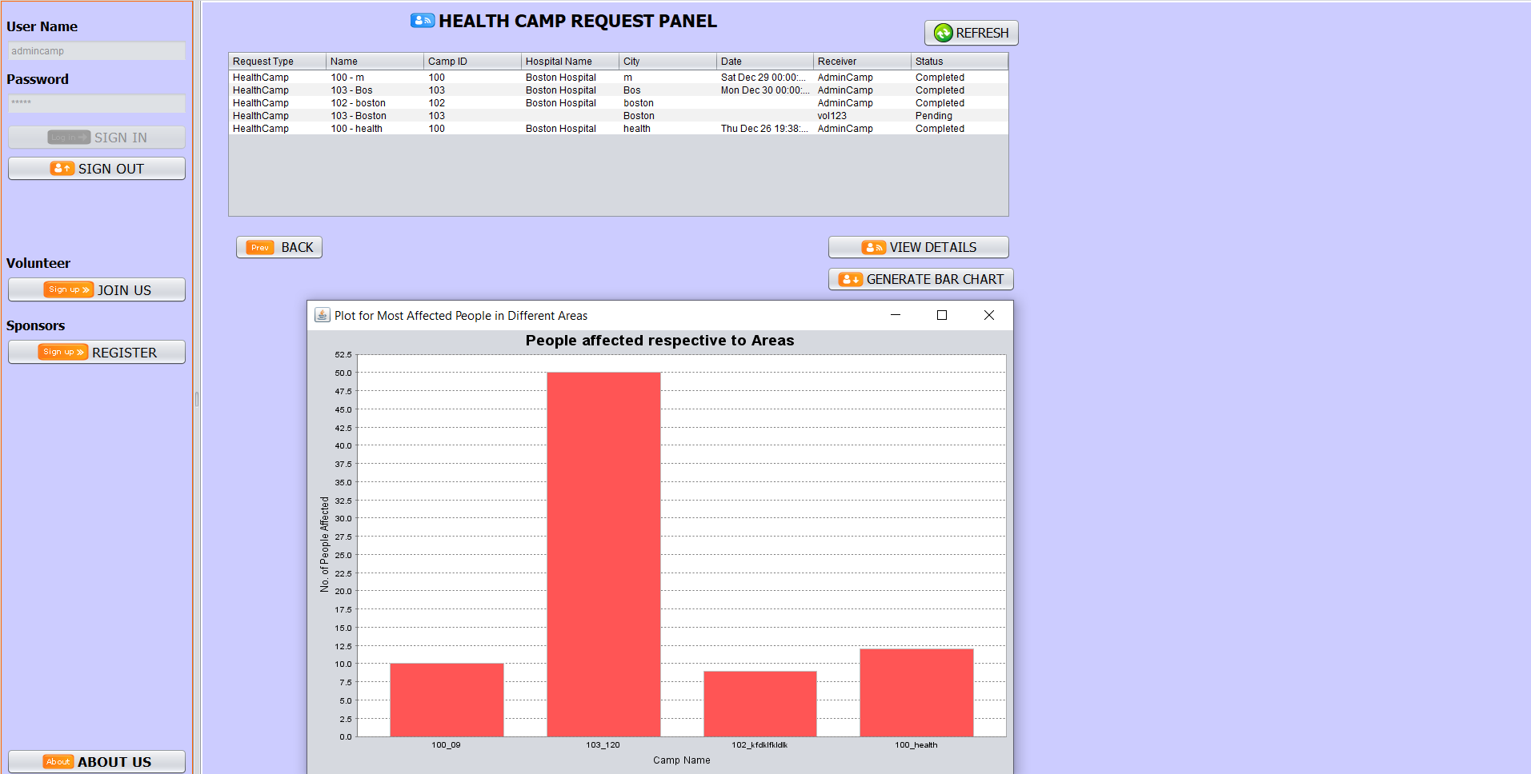
Health Camp Statistics
Nurse Work Area
Health Camp Approval

Slide 22
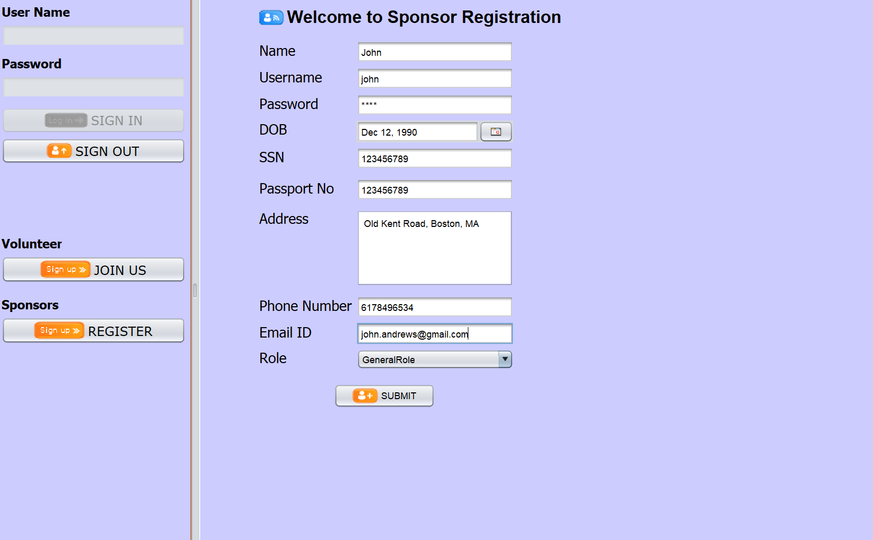
Patient Registration
Sponsor Registration

Slide 23
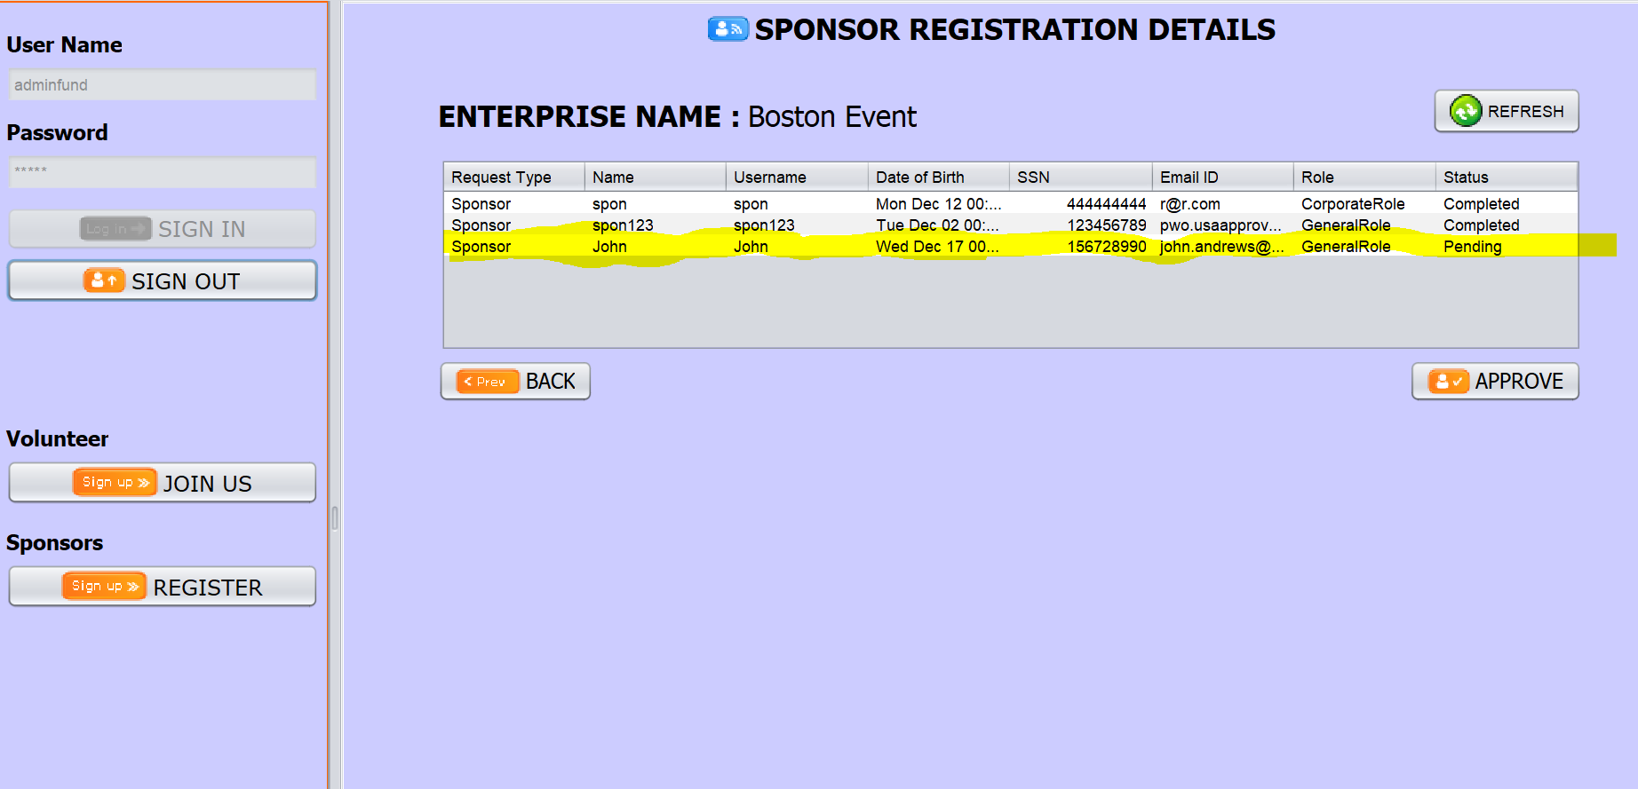
Health Camp Admin Login
Sponsor Approval

Slide 24
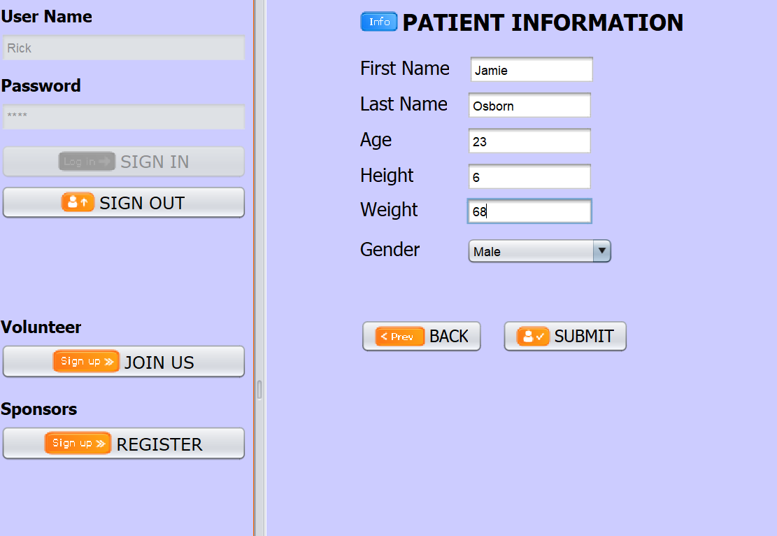
Patient Registration

Slide 25
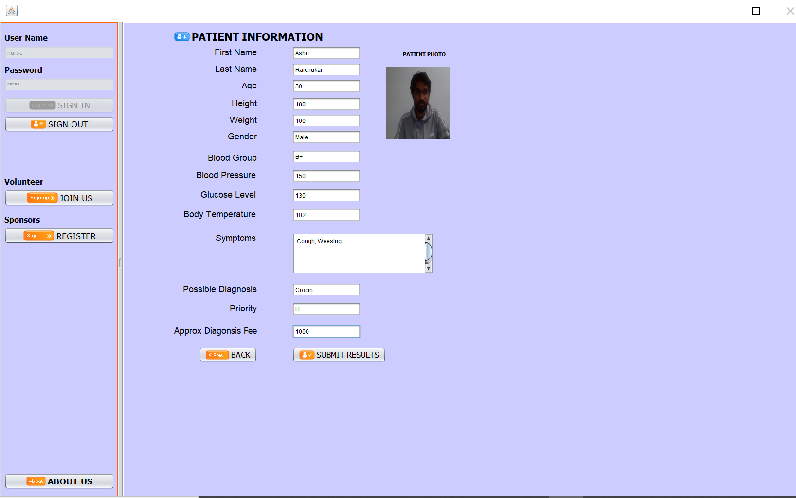
Patient Registration - Nurse
Patient Registration

Slide 26
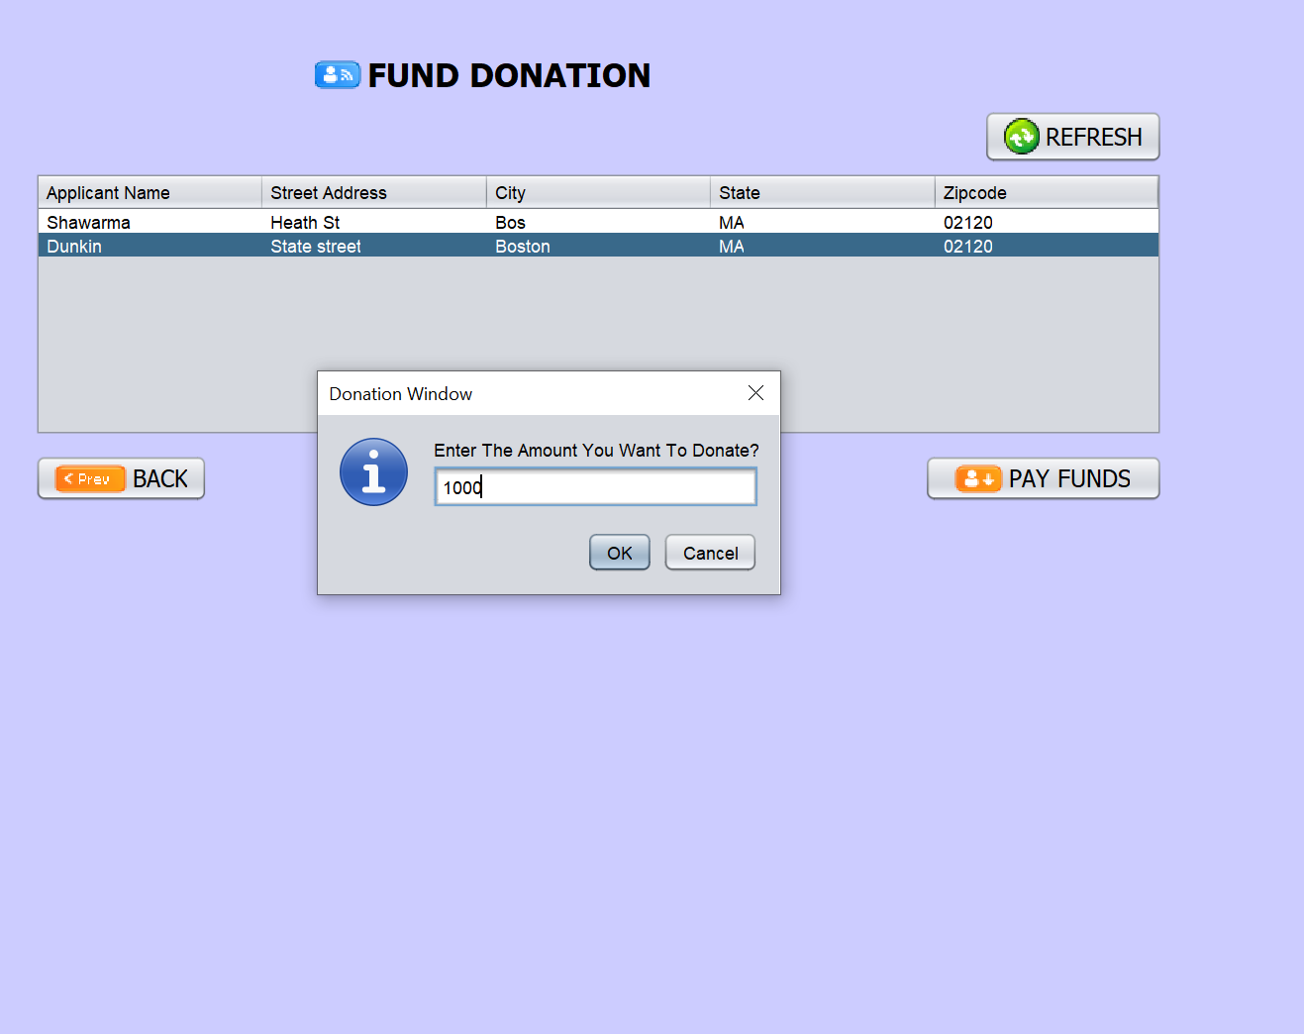
Sponsor Fund Donation
Patient Registration

Slide 27
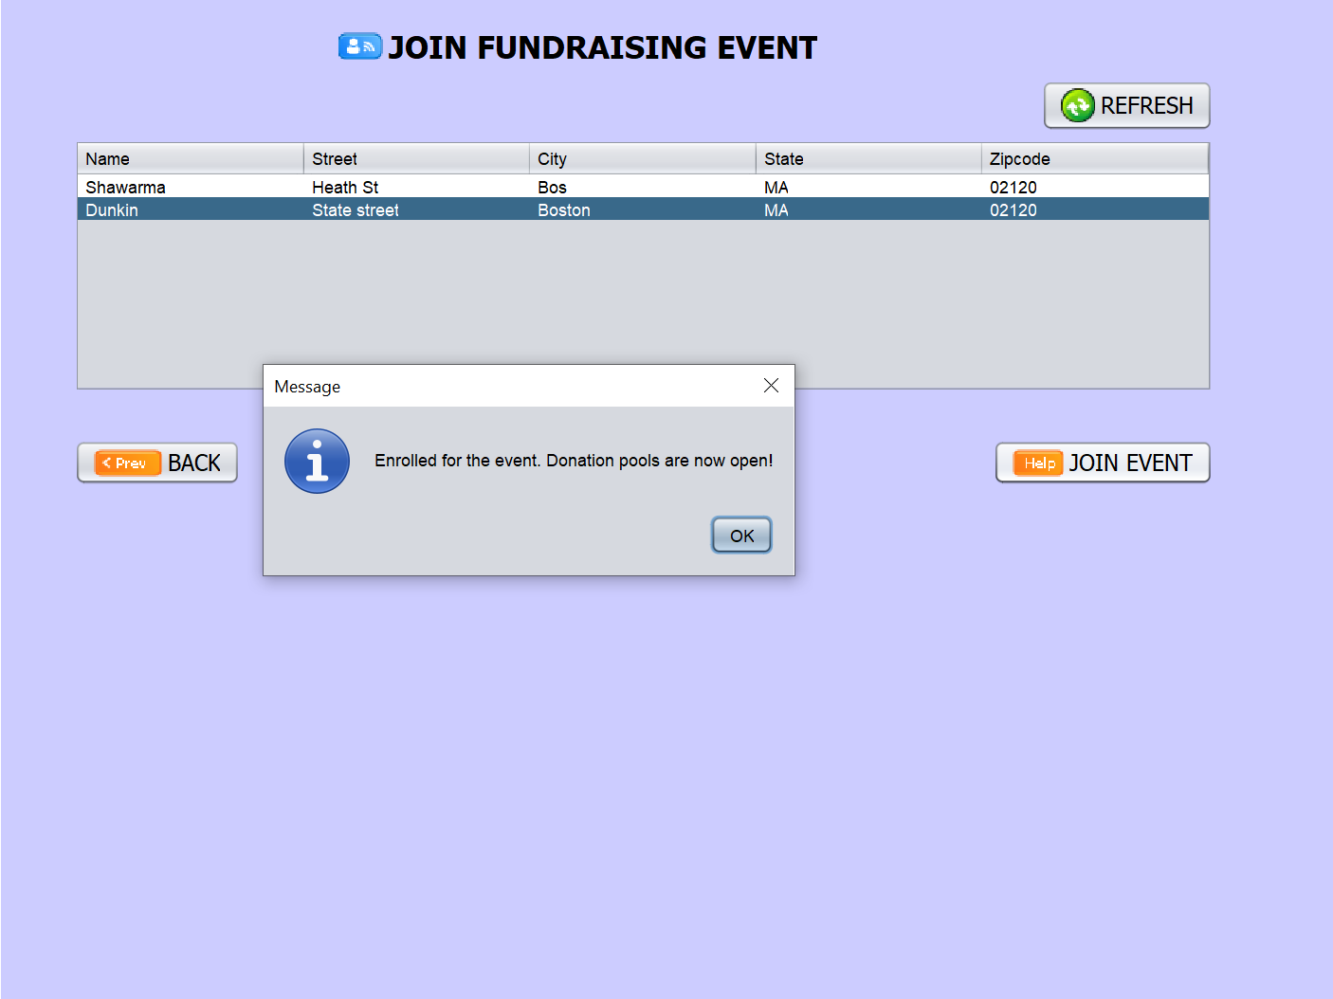
Fundraise Even Enrollment
Sponsor Fund Donation
Patient Registration

Slide 28
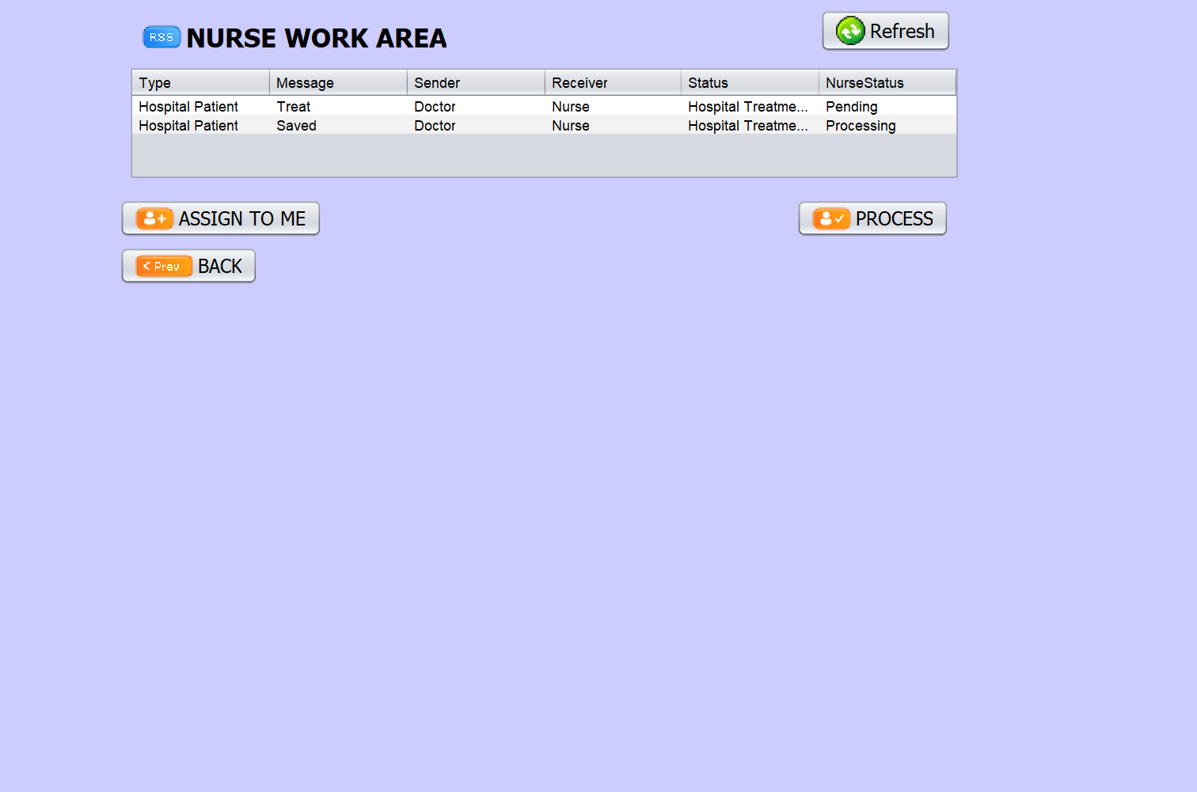
Nurse Work Area

Slide 29
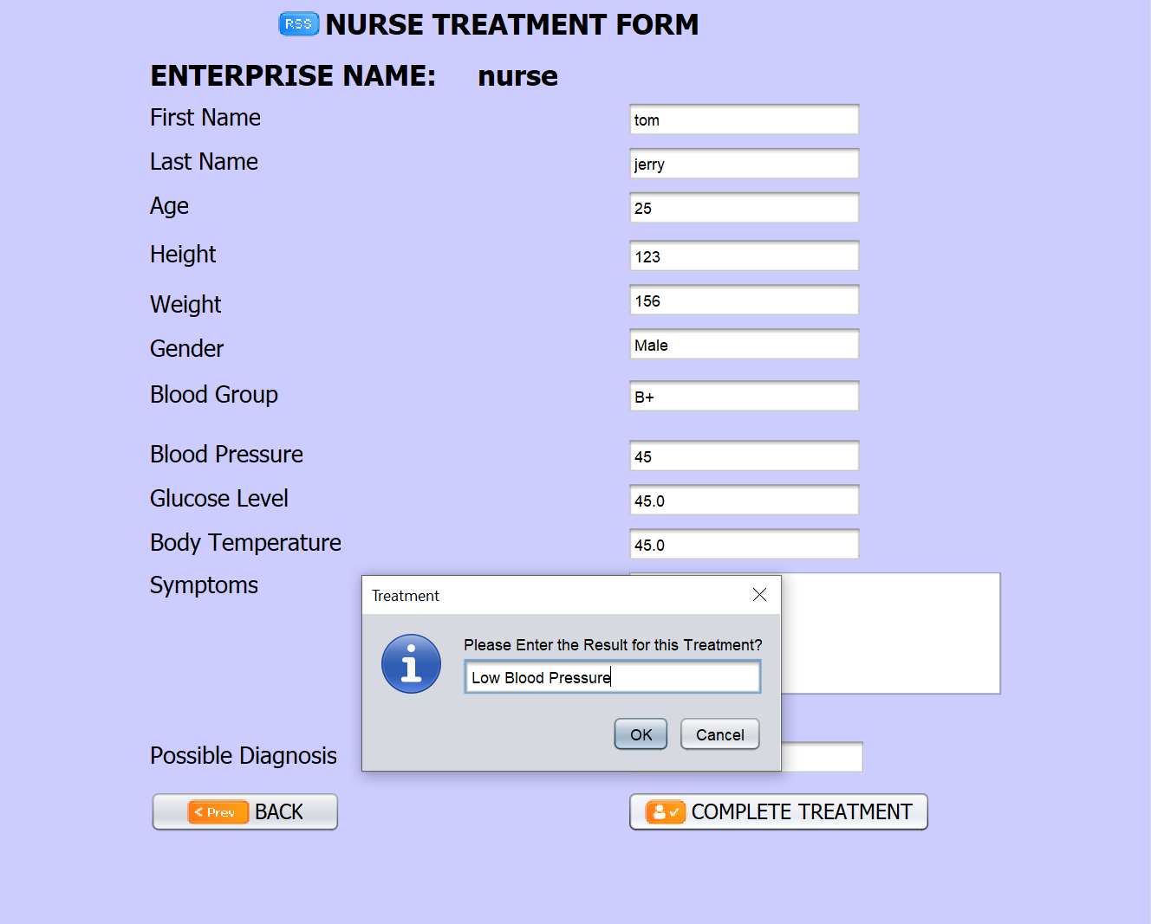
Nurse Work Area
Nurse Treatment Form

Slide 30
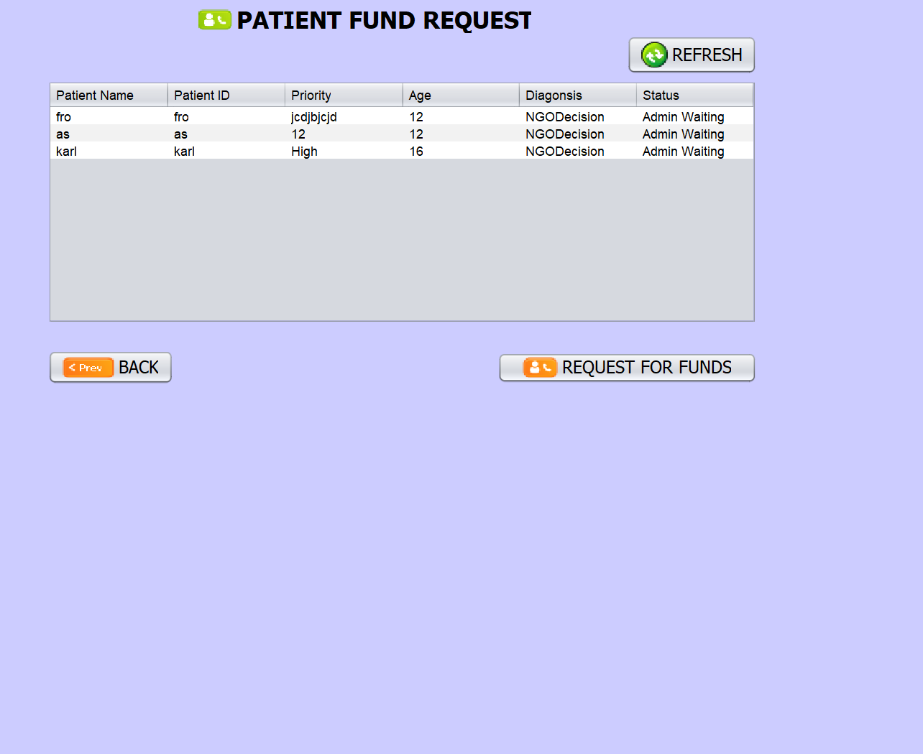
Nurse Work Area
Patient fund Request
Nurse Treatment Form

Slide 31
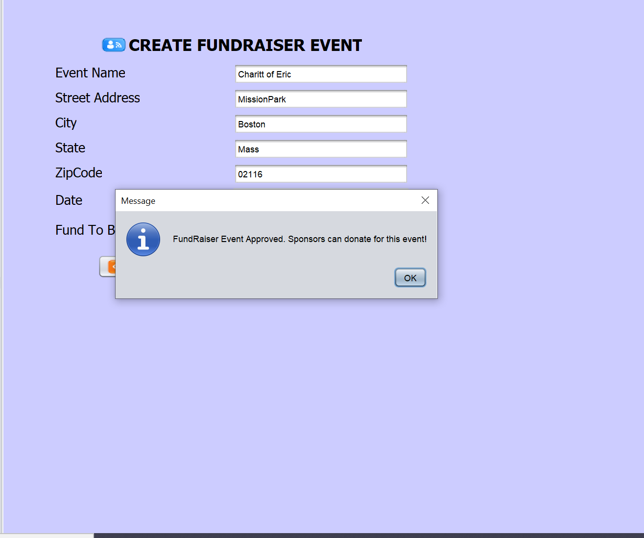
Nurse Work Area
Creating Fund Raising Event
Patient fund Request
Nurse Treatment Form

Slide 32
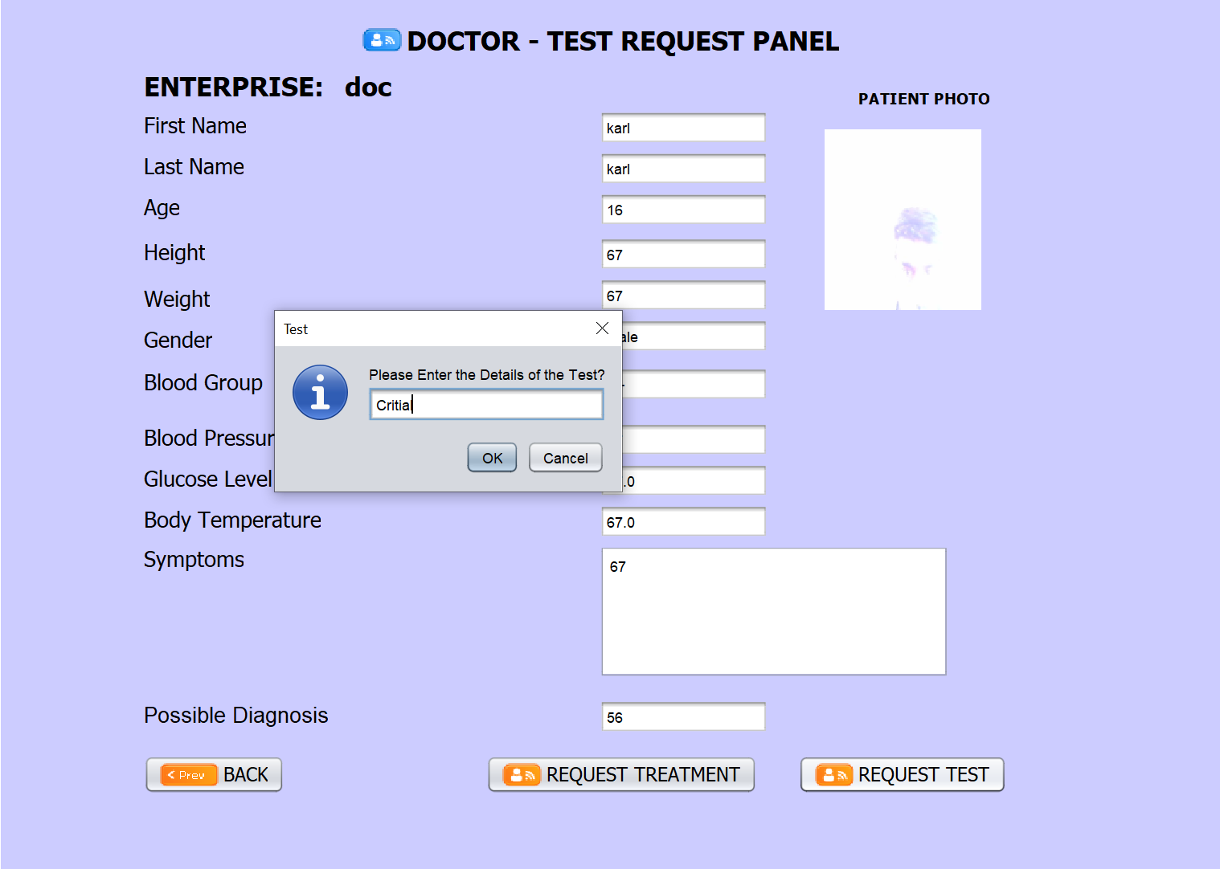
Doctor Work Area
Nurse Work Area

Slide 33
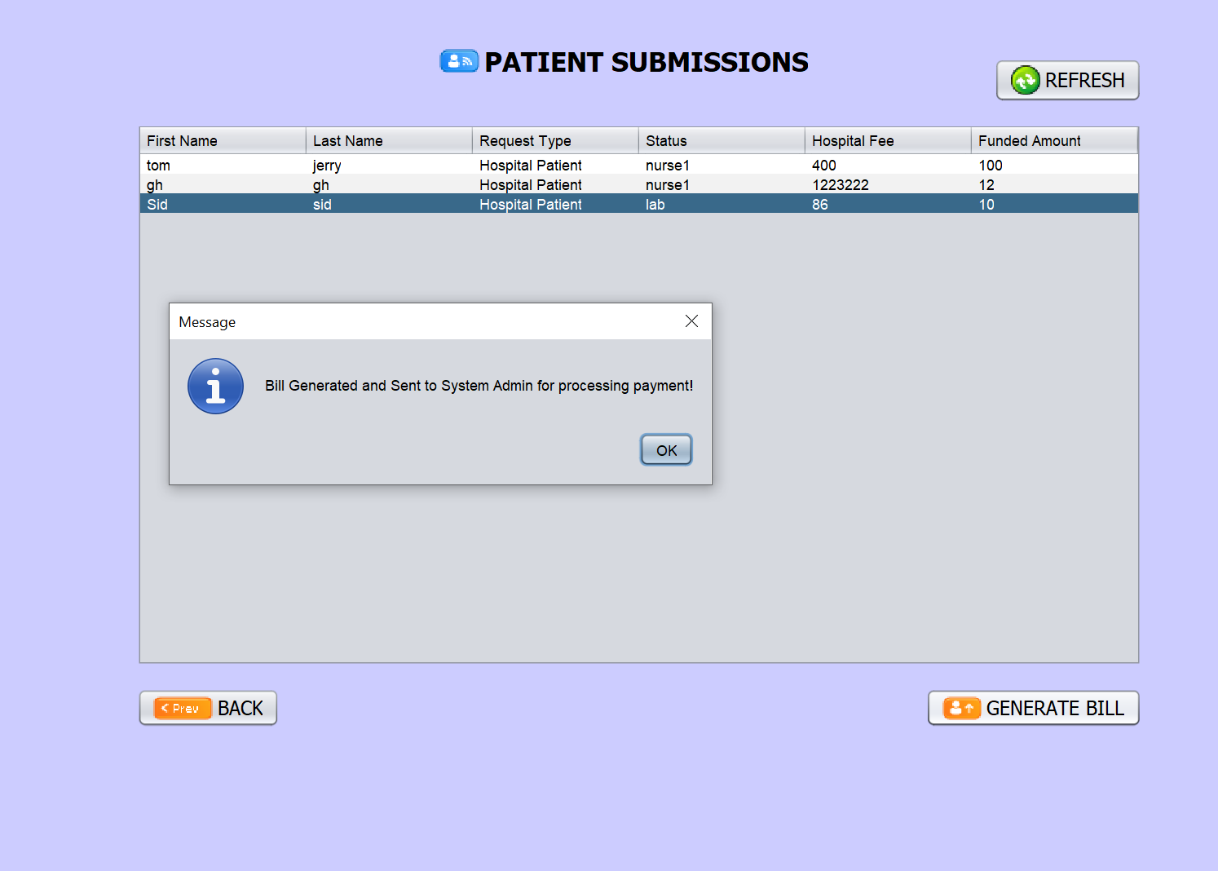
Doctor Work Area
Nurse Work Area
Receptionist Bill Generation

Slide 34
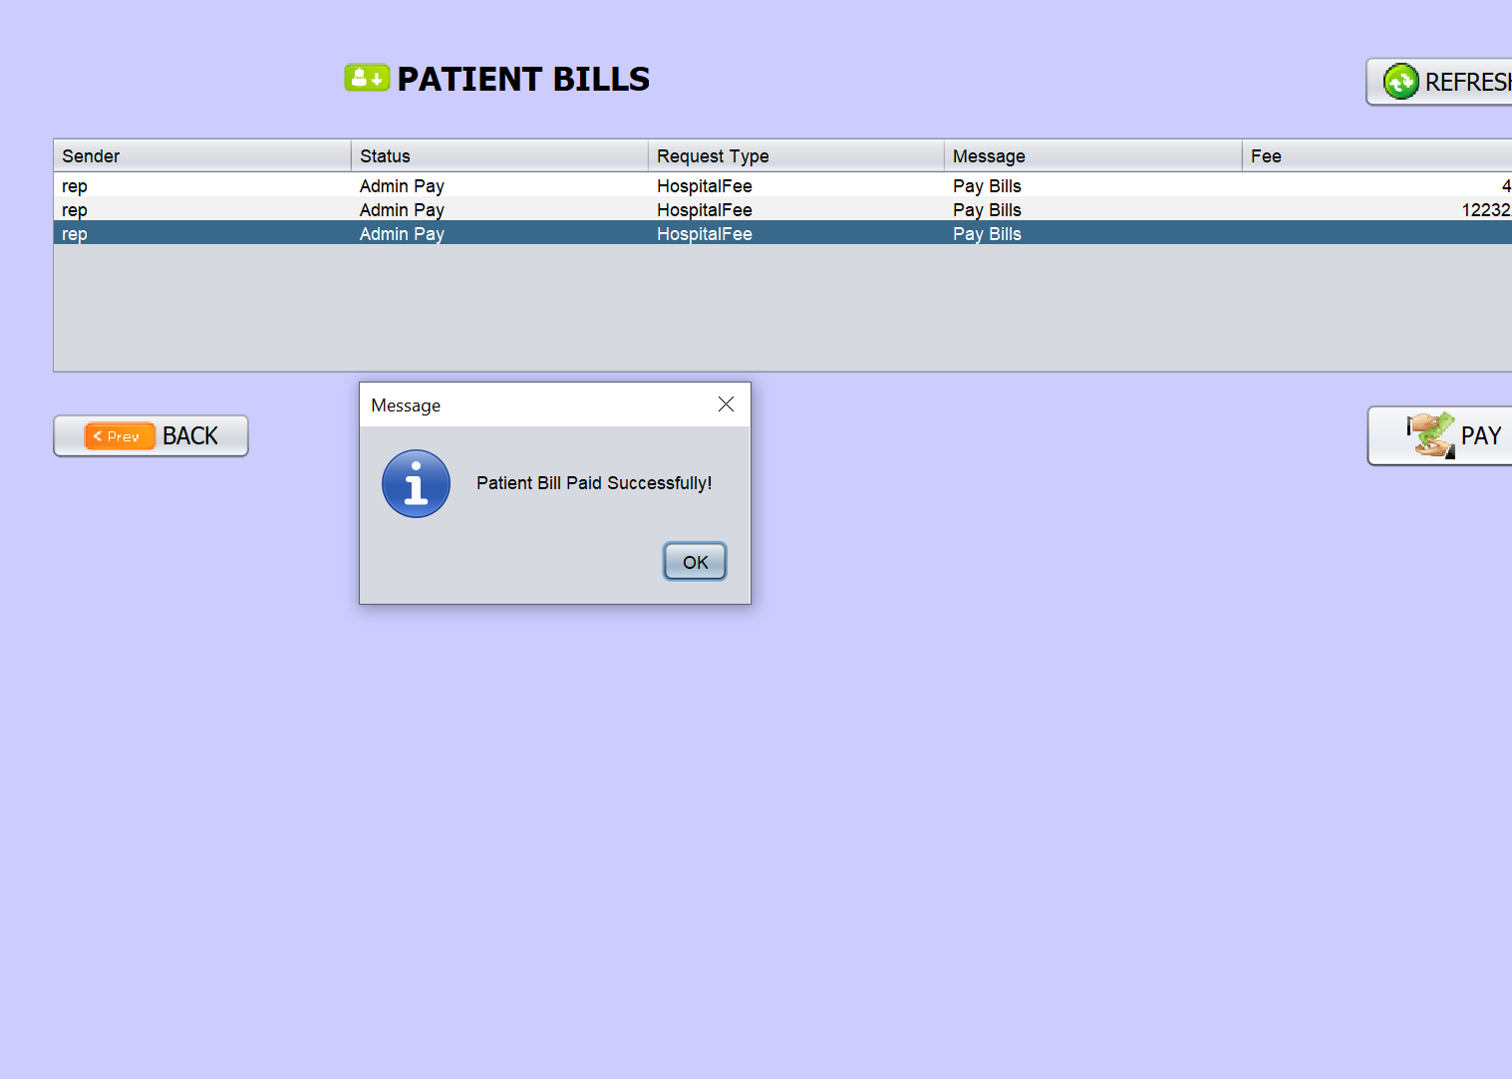
Doctor Work Area
Nurse Work Area
Hospital Bill for the Patient’s Treatment paid Successfully by PWO
Receptionist Bill Generation

Slide 35
Thank You!

